Slide 1
Customer Support Chatbot with Machine Learning
PIP2001 Capstone Project
Final-Review-4
Batch Number: CAI-G21
NAME | ROLL NO
VIDHYA SHREE V | 20211CAI0081
SALAPAKSHI SAGAR | 20211CAI0094
CHALLA YOGESH | 20211CAI0162
TALLA SUNIL KUMAR | 20211CAI0198
GADE PRATHYUSHA | 20211CAI0200
Under the Supervision of,
Dr.Afroz Pasha
Assistant Professor
School of Computer Science and Engineering
Presidency University
Name of the Program: Capstone Project
Name of the HoD: Dr.Zafar Ali Khan
Name of the Program Project Coordinator: Dr.Afroz Pasha
Name of the School Project Coordinators: Dr. Sampath A K / Dr. Abdul Khadar A / Mr. Md Ziaur Rahman

Slide 2
Content
Introduction
Literature Review
Objectives
Methodology
Timeline of the project
Expected Outcomes
Conclusion
References

Slide 3
Introduction
Problem Statement :
In this project, we aim to develop a machine learning-based customer support chatbot that can interpret customer queries, search databases for solutions, and escalate unresolved issues to human agents. The chatbot will incorporate speech-to-text functionality, multi-language support, and AI to answer simple questions without database searches. Additionally, it will feature a section dedicated to the seven most frequently asked questions (FAQs). Over time, the chatbot will learn from customer interactions, updating its knowledge base to provide more efficient and personalized support, ultimately enhancing customer satisfaction.

Slide 4
Literature Review
Author(s) | Year | Title | Journal/Conference | Key Findings/Contributions
Windiatmoko et al. | 2024 | Development of Facebook-based Chatbot Using RASA Framework | IEEE/ACM Transactions on Audi... | Developed a chatbot for university students using deep learning (LSTM). Provided 24/7 responses but faced challenges in personalization and handling complex conversations.
Katragadda | 2023 | Efficacy of Machine Learning-driven Chatbots and Virtual Assistants in Customer Support | Computer Speech & Language | Highlighted the role of machine learning (NLP and deep learning) in improving response accuracy and customer satisfaction. Noted the need for continuous model training for complex queries.
Iyambo and Iyawa | 2023 | AI-powered Customer Support Chatbots in the Insurance Sector | 10.21437/Interspeech.2022-10729 | Examined AI-driven chatbots' role in legal and compensation guidance. AI improved efficiency, but challenges like ambiguous queries and data privacy concerns remain.
Patel and Trivedi | 2022 | Integration of AI, ML, and NLP in Customer Service to Enhance Customer Loyalty | nsf.gov | Compared machine learning algorithms (Logistic Regression, KNN, SVM, Decision Tree, Random Forest).
Ebsen et al. | 2022 | Customer Service Chatbot Development Using Python and OpenAI API | https://arxiv.org/abs/2112.08352v2 | Compared OpenAI API and LangChain framework for chatbot development. LangChain offered concise code, while OpenAI provided detailed responses, showing trade-offs between simplicity and depth.

Slide 5
Objectives
Develop a customer support chatbot that can understand and respond to customer queries using
Natural Language Processing (NLP) and machine learning techniques.
Integrate speech-to-text functionality to allow customers to interact with the chatbot using voice commands, enhancing accessibility.
Implement multi-language support to cater to a diverse global audience, making the chatbot useful across different regions and languages.
Enable AI-driven responses for simple, frequently asked questions without querying the database, improving response efficiency.
Create a dedicated section for the seven most frequently asked questions (FAQs) to provide quick and easy access to common solutions.
Escalate unresolved or complex issues to human support agents when necessary, ensuring comprehensive customer care.
Continuously improve the chatbot's performance by using machine learning to learn from customer interactions and update the database for future use.

Slide 6
Methodology
Requirement Analysis:
Identify key functionalities such as speech-to-text integration, multi-language support, FAQ module, and issue escalation.
Determine the necessary APIs and frameworks like Google Speech-to-Text API and multilingual Natural Language Processing (NLP) libraries.
2. Data Collection & Preprocessing:
Collect data from previous customer interactions for training.
Preprocess the text data by tokenization, removing stop words, and applying stemming to prepare for NLP model training.
3. Model Development:
Natural Language Processing (NLP): Implement OpenAI’s GPT for natural language understanding and query resolution.
LangChain Framework: Utilize this to streamline interaction flow and ensure efficient API management.
Speech Recognition: Integrate Google’s Speech-to-Text API to enable voice-based queries.

Slide 7
Methodology
4. Multi-Language Support:
Use Google Translate API or similar translation services to offer real-time multilingual responses.
Implement multilingual NLP techniques such as word embeddings and tokenization to enhance language understanding.
5. FAQs Module:
Use clustering algorithms and frequency analysis to dynamically identify and store the most frequently asked questions.
Regularly update the FAQ section by monitoring user interactions and emerging queries.
6. Escalation Mechanism:
Implement a decision-tree model to detect complex or unresolved issues and trigger an automated ticketing system for human escalation.
Ensure seamless integration with human agents through the system for enhanced customer support.

Slide 8
Methodology
7. Learning and Improvement:
Apply supervised learning techniques to enhance the chatbot's response accuracy.
Implement reinforcement learning to allow the chatbot to improve from user feedback, optimizing its performance over time.
8. Testing and Deployment:
Test the chatbot for response accuracy, multi-language capabilities, and speech recognition efficiency.
Deploy the system across platforms (web, mobile) and monitor its performance through metrics like user satisfaction and response time.

Slide 9
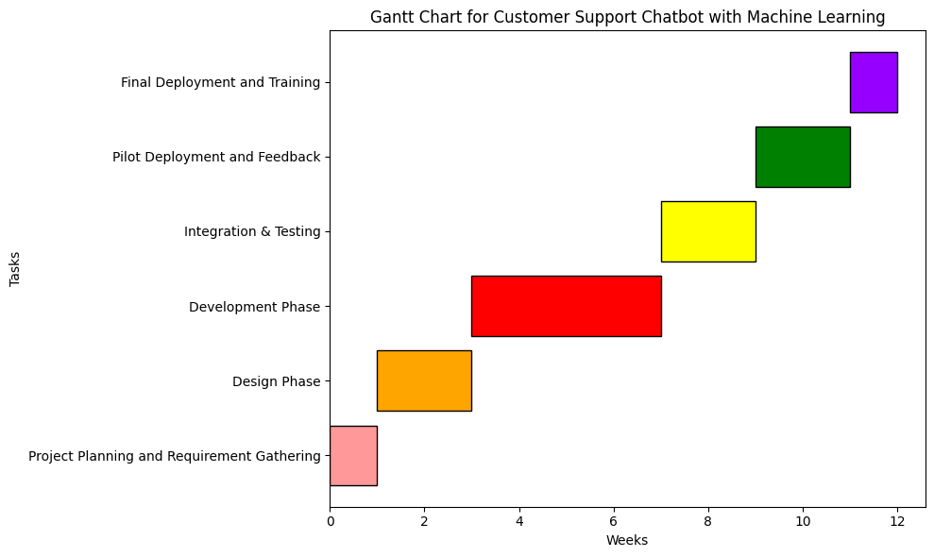
Timeline of the Project (Gantt Chart)
Project Planning and Requirement Gathering (Ongoing)
Design Phase
Development Phase
Integration & Testing
Pilot Deployment and Feedback
Final Deployment and Training
Maintenance and Support

Slide 10
Expected Outcomes
Efficient Query Resolution: The chatbot will resolve common customer queries quickly using NLP and machine learning, reducing the workload on human agents.
Multi-Language Support: Customers will be able to interact with the chatbot in multiple languages, improving global accessibility.
Speech-to-Text Functionality: Customers can input queries via voice, enhancing user experience and accessibility.
AI-Driven FAQs: A dynamic section for frequently asked questions will provide instant solutions, streamlining user interactions.
Escalation of Complex Issues: Unresolved queries will be automatically escalated to human support agents, ensuring comprehensive customer service.
Continuous Improvement: Machine learning algorithms will enable the chatbot to improve over time, learning from interactions to deliver more accurate responses.

Slide 11
Conclusion
The "Customer Chatbot using Machine Learning" aims to automate customer support, leveraging AI to improve query resolution, accessibility, and language support. By combining machine learning, NLP, and voice recognition, the chatbot will reduce the burden on human support agents and provide real-time, efficient customer service. Continuous learning from customer interactions will ensure that the chatbot adapts and improves over time, leading to better service quality and higher customer satisfaction.

Slide 12
References :
1. ResearchGate. (2020). Customer Support Chatbot Using Machine Learning.
https://www.researchgate.net/publication/343980800_Customer_Support_Chatbot_Using_Machine_Learning
2. IRJET. (2023). A Comprehensive Study on Decision-Tree-Based Customer Support Chatbot Systems.
https://www.irjet.net/archives/V10/i12/IRJET-V10I12101.pdf
3. IIIS. (2024). Enhancing Multi-Language Chatbots for Global Customer Support.
https://www.iiis.org/CDs2024/CD2024Spring//papers/ZA198JE.pdf
4. SSRN. (2023). Continuous Learning and Reinforcement Models in Customer Service Chatbots.
https://papers.ssrn.com/sol3/papers.cfm?abstract_id=4649539

Slide 13
References:
5. IJMERR. (2020). Clustering Algorithms for Optimizing Chatbot FAQ Modules.
https://www.ijmerr.com/uploadfile/2020/0312/20200312023706525.pdf
6. ResearchBerg. (2021). Data Preprocessing for NLP in Customer Support Chatbots.
https://www.researchberg.com/index.php/eqme/article/view/46
7. DLABI. (2021). Integration of Speech-to-Text in Chatbots Using Google APIs.
https://dlabi.org/index.php/journal/article/view/106
8. IRE Journals. (2021). Performance Evaluation Metrics for Chatbots Post- Deployment.
https://www.irejournals.com/formatedpaper/17048601.pdf

Slide 14
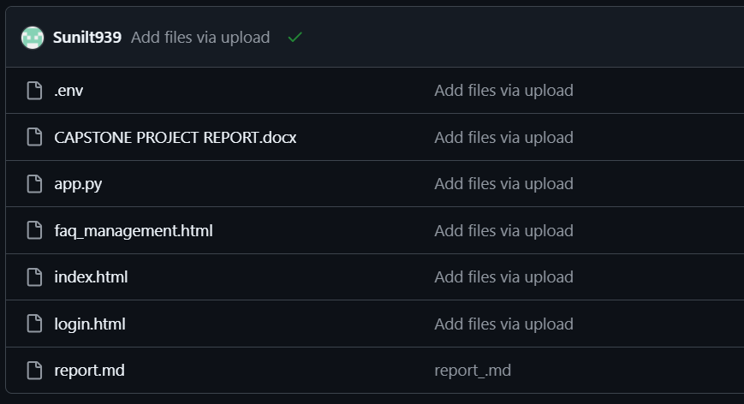
GITHUB LINKS
https://github.com/Sunilt939/chatbot-project

Slide 15


